Slide 1

Green Pace
Security Policy Presentation
Developer: Michael Neff
CS 405

Slide 2

OVERVIEW: DEFENSE IN DEPTH
Defence in depth can be viewed as a securty mechansim that has multiple layers of defence in order provide defence and protect system vulnerabilities.

Slide 3
THREATS MATRIX
 | LOW | MEDIUM | HIGH
LIKELY | MSC33-C IDS00-J OOP52-CPP |  | DCL03-C ERR60-CPP
PROBABLE | ERR60-CPP | CON50-CPP | CON52-CPP
UNLIKELY | DCL12-C. ERR34-C | FIO51-CPP | STD-001-CPP

Slide 4
10 PRINCIPLES
-Validate Input Data:
DCL12-C
-Heed Compiler Warnings:
MSC33-C
-Architect and Design for Security Policies:
ERR34-C
-Keep It Simple:
IDS00-J
-Default Deny:
CON52-CPP
-Adhere to the Principle of Least Privilege:
DCL03-C
-Sanitize Data Sent to Other Systems:
ERR60-CPP
-Practice Defense in Depth:
OOP52-CPP
-Use Effective Quality Assurance Techniques:
CON50-CPP
-Adopt a Secure Coding Standard:
FIO51-CPP

Slide 5
CODING STANDARDS
Rule | Severity | Likelihood | Remediation Cost | Priority | Level
STD-001-CPP | High | Unlikely | Medium | High | 2
DCL12-C. | Low | Unlikely | High | P1 | L3
MSC33-C | Low | Likely | Low | P27
ERR34-C | Low | Unlikely | Medium | P4 | L3
IDS00-J | Low | Likely | Medium | P18 | L1
CON52-CPP | High | Probable | Medium | P8 | L2
DCL03-C | High | Likely | Medium | P18 | L1
ERR60-CPP | High | Likely | Medium | p18 | L1
ERR60-CPP | Low | Probable | Medium | P4 | L3
OOP52-CPP | Low | Likely | Low | P9 | L2
CON50-CPP | Medium | Probable | High | P4 | L3
FIO51-CPP | Medium | Unlikely | Medium | P4 | L3
[List the 10 coding standards. Explain your own ranking system for vulnerabilities, using specific details from the coding standards in your security policy.]

Slide 6
ENCRYPTION POLICIES
Encryption In rest Is data that is stored on a physical memory device, like hard drives, SSD’s and even as far as cloud storage. The encryption at rest protects data from an unauthorized breach. It plays a crucial role for defending sensitive information from exposure, especially when a device becomes lost.
Encryption in flight Data that is being transferred from one location over a network used encryption in flight. The end game is that encryption in flight is protecting data against interception while being transmitted.
Encryption in use Is unlike encryption at rest and flight. This encryption protects data specific to states, and is used to secure data while in use. This protects against threats such as unauthorized or non authenticated breaches, and or memory scraping. This form of encryption ensures that information remains protected.

Slide 7
TRIPLE-A POLICIES
Authentication is verification of identify of users or systems before access is granted. There are many ways to authenticate a user. Unique passwords, biometric and pin codes, multi factor authentication is also common. These steps ensure that the information is correct and can provide access to anyone who is authenticate.
Authorization is the process after the authentication verifies identity. Authorization defines the levels of permissions granted to a user. This can be done to specific roles if relating to a work place system.
accounting.
Accounting involves tracking and recording of users data. This includes logging, file access, and changes to usage. This is essential for monitoring security compliance and it also helps ensure that policies and security’s are in place.

Slide 8
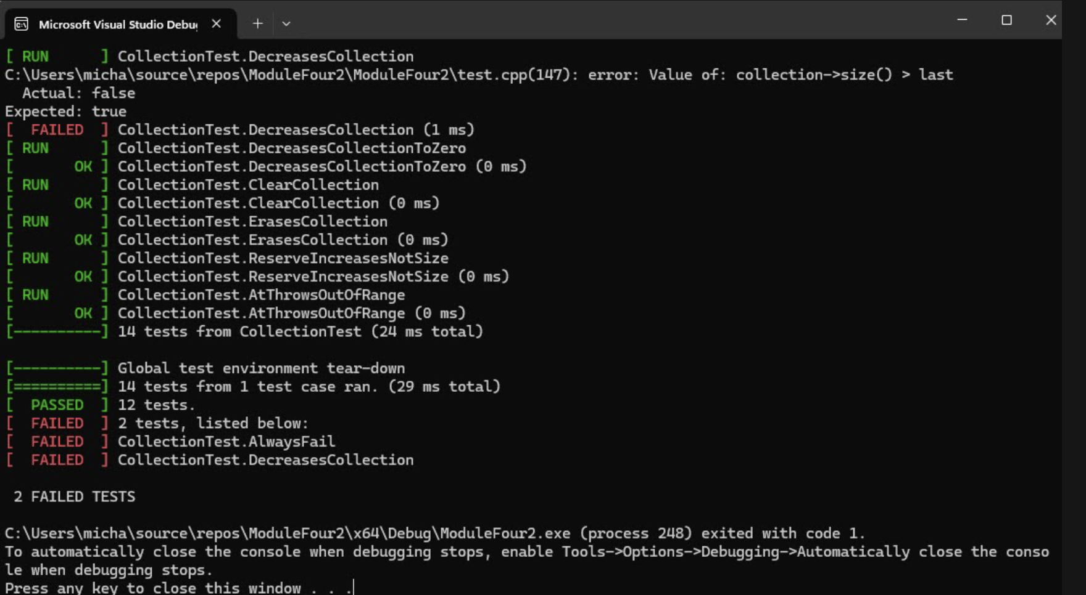
Unit Testing
Testing can be done to ensure that proper buffers and overflow errors can be detected. Tests like esuring collection size if its -> if its empty or collection size not empty. many tests can be performed such as seen on the screen shot.

Slide 9

AUTOMATION SUMMARY

Slide 10
TOOLS
What Is DevSevOps Pipeline?
Summary Diagram
OSWAP Threat Dragon
CheckMarx
Container Tools

Slide 11
RISKS AND BENEFITS
Problems
Soultions
Risks
Steps to Take

Slide 12
RECOMMENDATIONS
Gaps in Early Statges
Non Exisitent complice measures
Outdated or NO Management

Slide 13
CONCLUSIONS
Applying good coding practices and following a well-structured plan are crucial for successful deployment in DevOps. Integrating security into DevOps (DevSecOps) not only reduces costs but also helps ensure an application is free from vulnerabilities. Understanding and monitoring risks, as well as their frequency, are essential for preventing breaches and maintaining a secure program.

